Slide 1
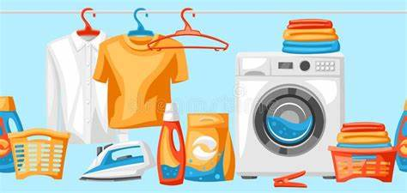
Laundry

Slide 2
WEB DEVELOPMENT
Web development refers to the building, creating, and maintaining of websites. It includes aspects such as web design, web publishing, web programming, and database management. It is the creation of an application that works over the internet i.e. websites.

Slide 3
HTML: HTML stands for HyperText Markup Language. It is used to design the front end portion of web pages using markup language. It acts as a skeleton for a website since it is used to make the structure of a website.
CSS: Cascading Style Sheets fondly referred to as CSS is a simply designed language intended to simplify the process of making web pages presentable. It is used to style our website.
JavaScript: JavaScript is a scripting language used to provide a dynamic behavior to our website.

Slide 4
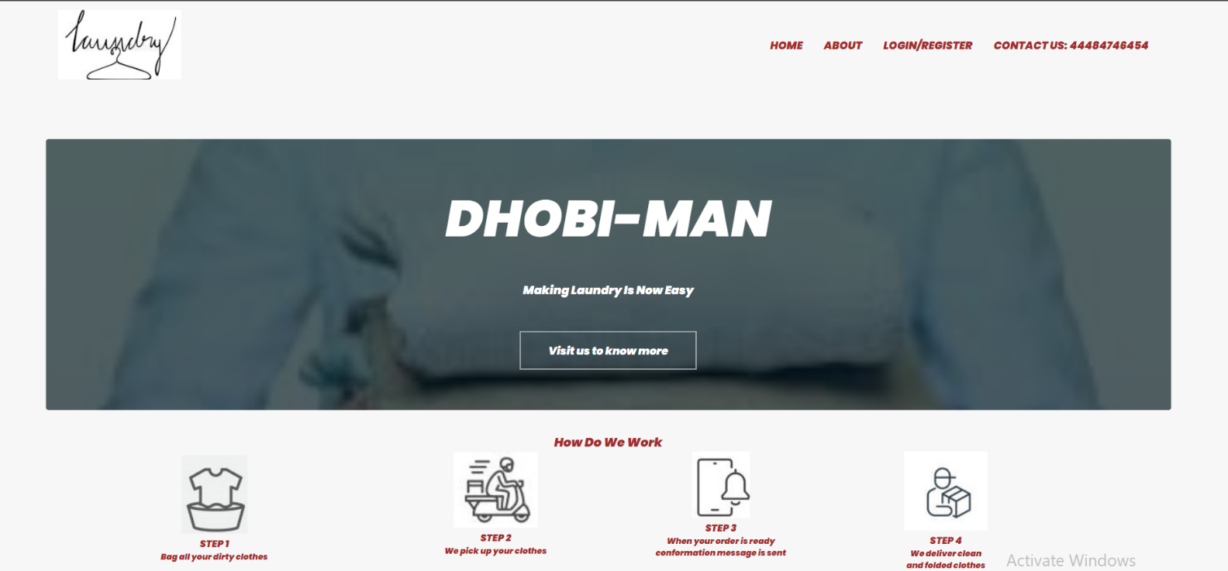
Multi Page Responsive Website
Our website is a basic food ordering website ,which is multipage responsive.

Slide 5
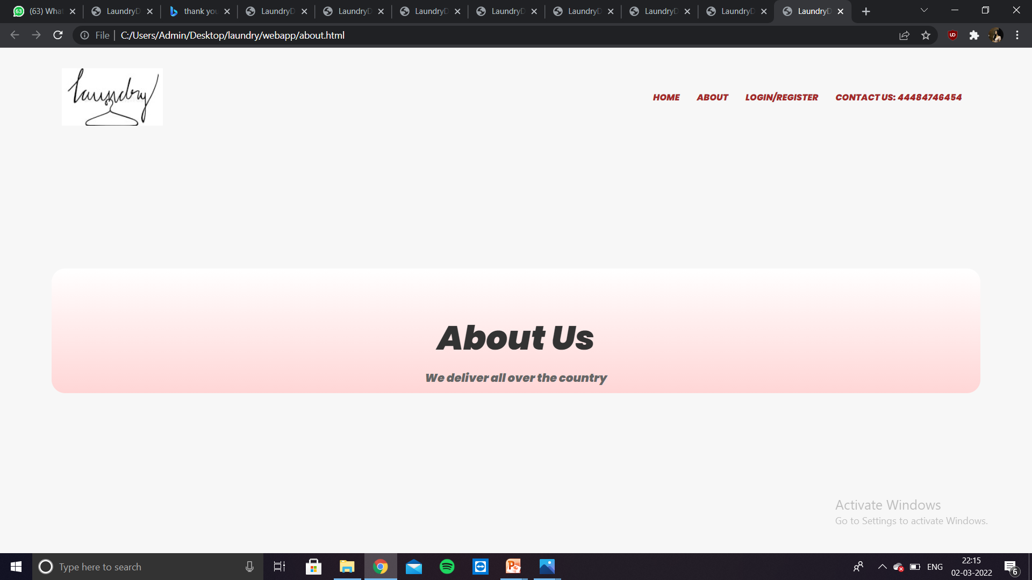
About

Slide 6
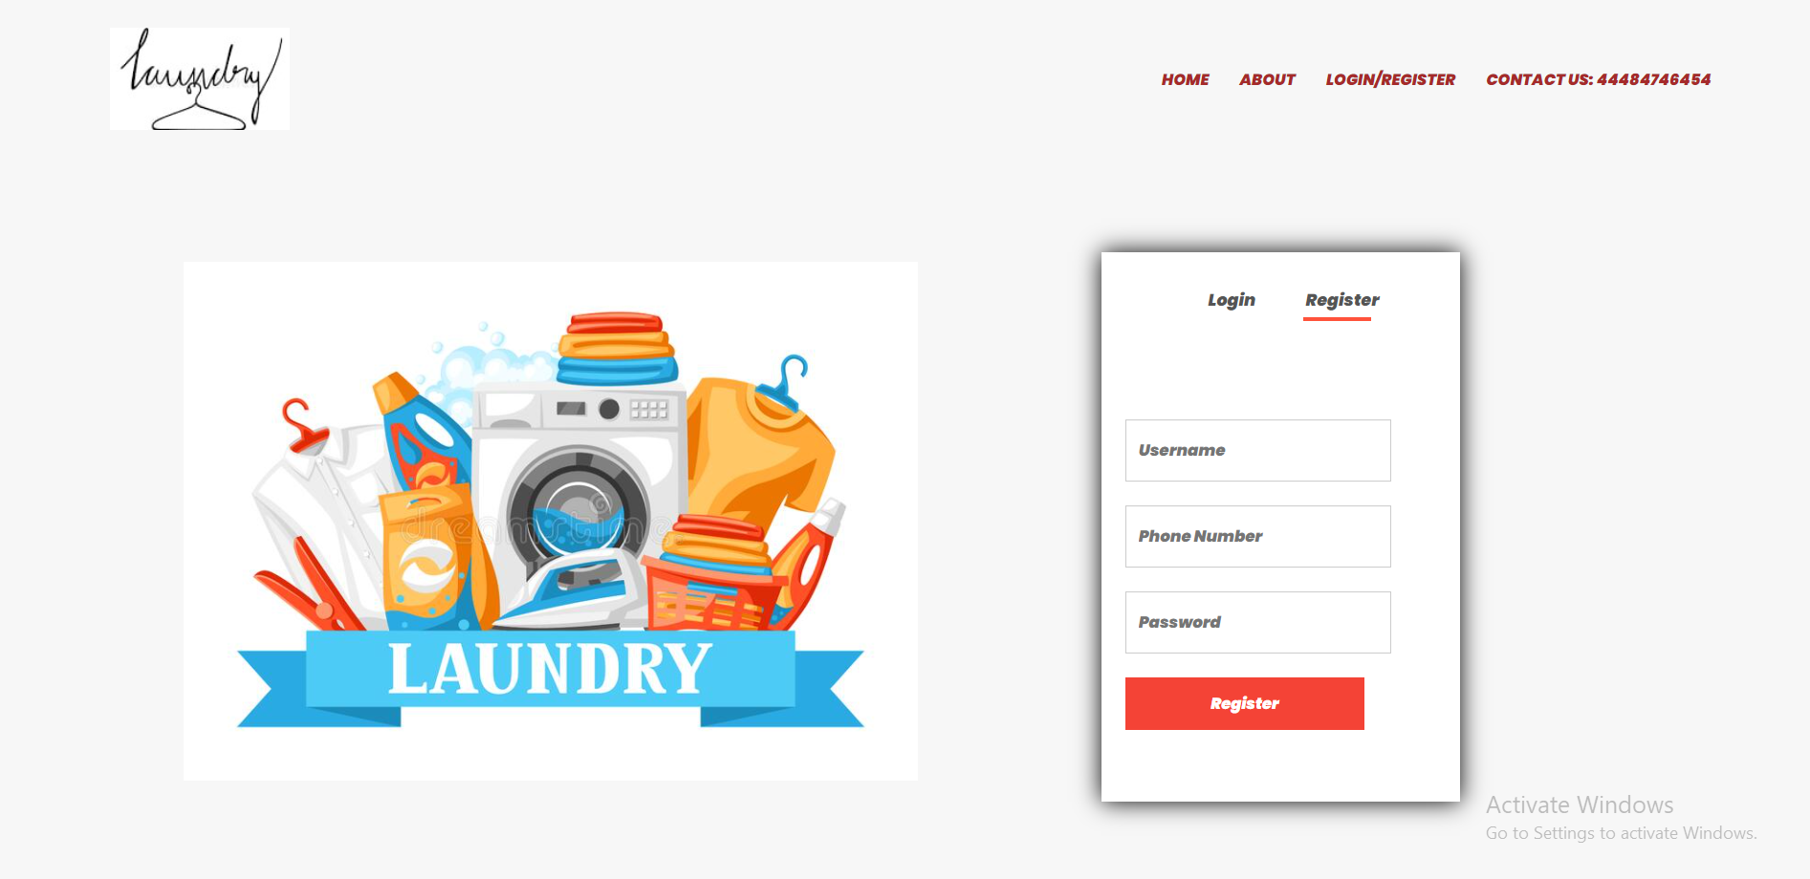
Register

Slide 7
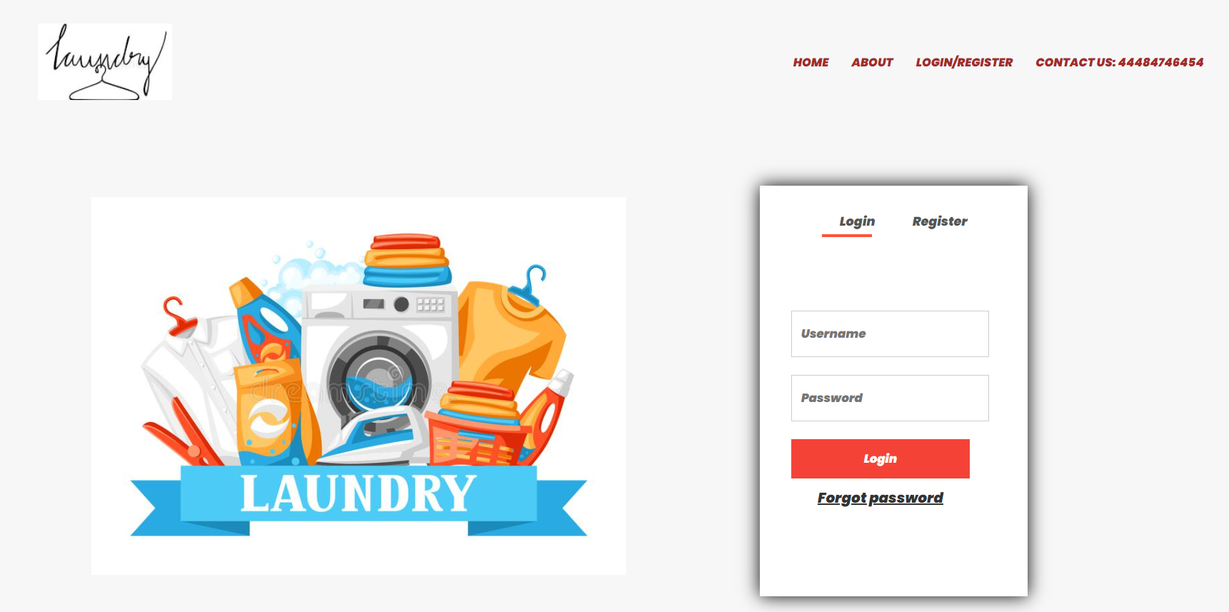
Login

Slide 8
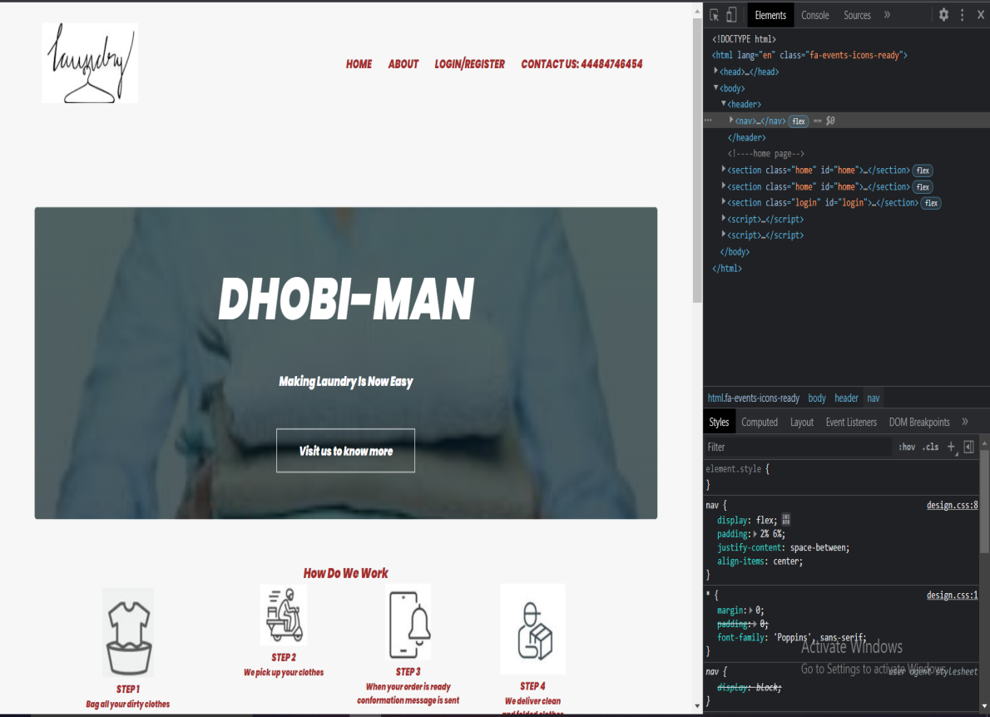
Special Feature
Our website can be accessed from any kind of devices like laptop , i pad , tablets , smart tv, smartphones etc..

Slide 9
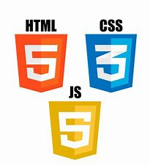
Languages Used
We have used HTML (Hyper Text Markup Language),CSS(Cascading Style Sheet) and JS(Java script).

Slide 10
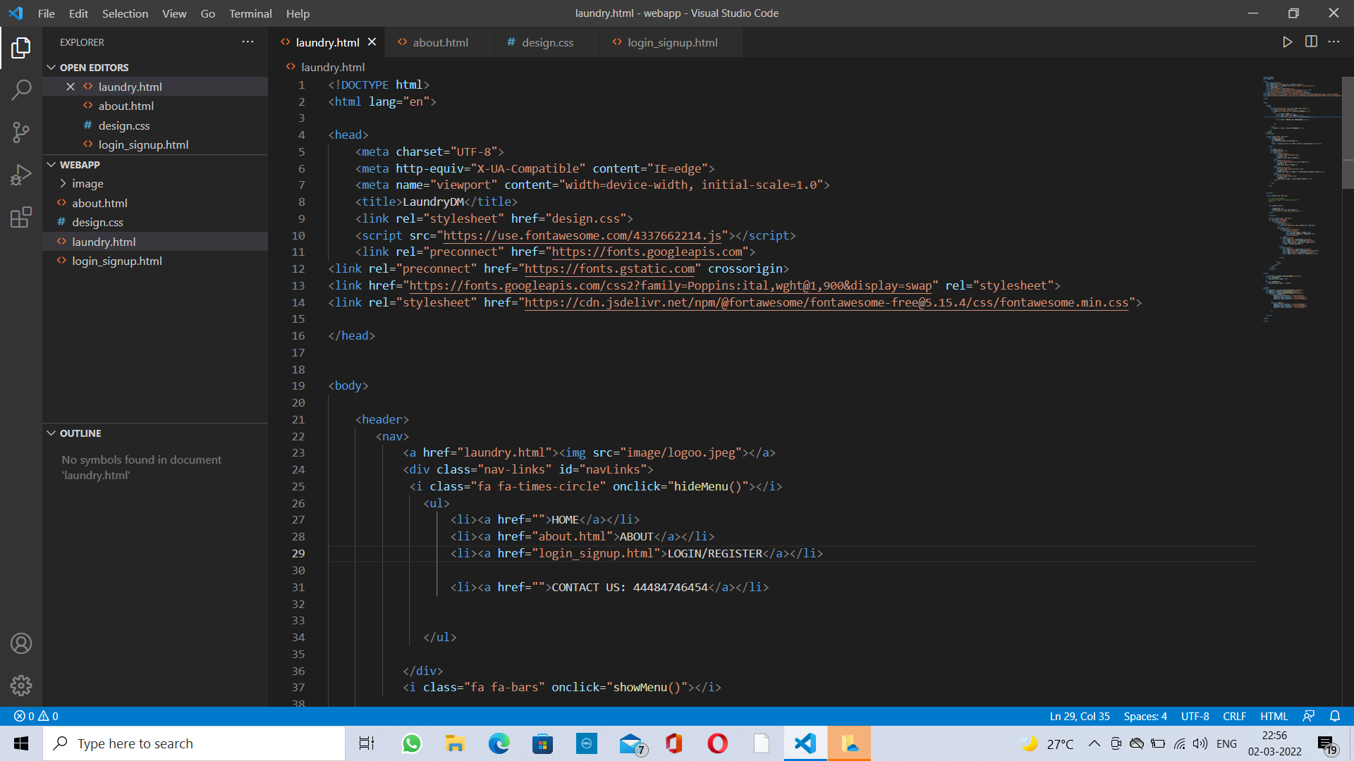
HTML CODE

Slide 11
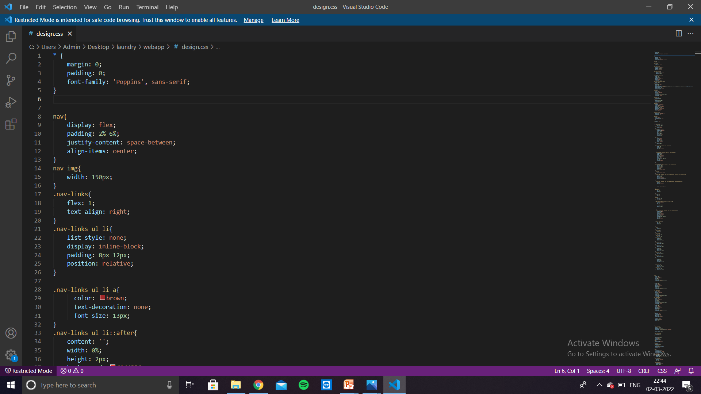
CSS CODE

Slide 12
Advantages:
Specific
Website can be used from any device,browser.
General
Saves Customer time
Saves Customer energy.

Slide 13


